Slide 1
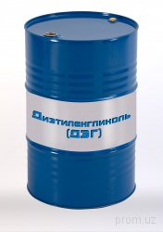

PROJECT NAME | DEVELOPMENT OF PRODUCTION OF CHEMICAL REAGENTS
Technical requirements | Diethylene glycol for gas drying
Project implementation period | 2020-2021 y.
Current import volume per year | $ 0.2 million
Localization percentage | At least 60%
Creation of new jobs | 5 people.

