Slide 1
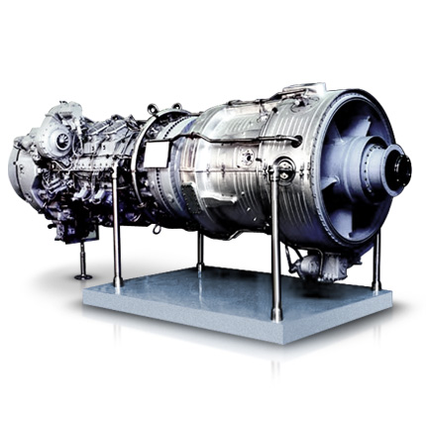
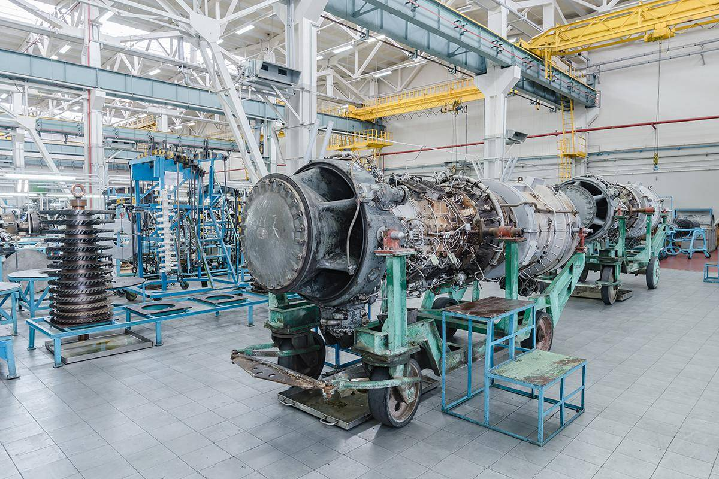
PROJECT NAME | ORGANIZATION OF CAPITAL REPAIR OF GAS TURBINE ENGINES
Project implementation period | 2020-2023 y.
Volume of investment | $ 65.0 million USD
Current import volume per year | $ 18-22 million USD
Localization level | At least 50%
Creation of new jobs | 35 people.

