Slide 1
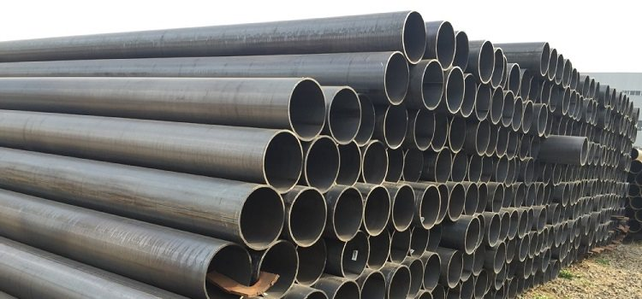
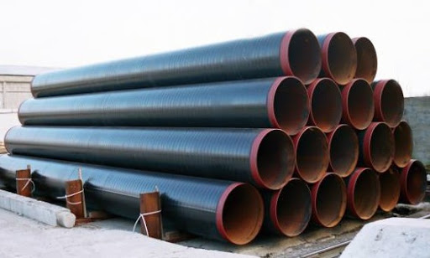
PROJECT NAME | DEVELOPMENT OF PRODUCTION OF PIPES FOR MAIN GAS PIPELINES
Technical requirements | Pipes with a diameter from 300 to 1020 mm
Project implementation period | 2020-2025 y.
Investment volume | Determined by
Current import volume per year | 7-9 million dollars. USA
Localization percentage | At least 30%
Creation of new jobs | 50 people.

